Slide 1
λ-NFA to DFA
Ms.M.Prathilothamai
Assistant Professor(Sr.Gr)
Department of Computer Science
Amrita School of Engineering

Slide 2
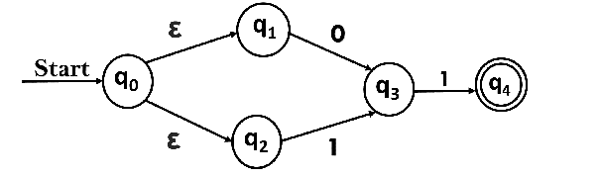
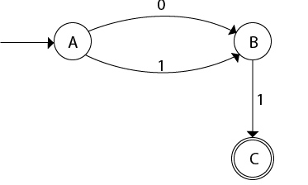
λ-NFA Example
Let us obtain ε-closure of each state.
ε-closure {q0} = {q0, q1, q2}
ε-closure {q1} = {q1}
ε-closure {q2} = {q2}
ε-closure {q3} = {q3}
ε-closure {q4} = {q4}

Slide 3
Now, let ε-closure {q0} = {q0, q1, q2} be state A.
δ'(A, 0) = ε-closure {δ((q0, q1, q2), 0) }
= ε-closure {δ(q0, 0) ∪ δ(q1, 0) ∪ δ(q2, 0) }
= ε-closure {q3}
= {q3} call it as state B.
δ'(A, 1) = ε-closure {δ((q0, q1, q2), 1) }
= ε-closure {δ((q0, 1) ∪ δ(q1, 1) ∪ δ(q2, 1) }
= ε-closure {q3}
= {q3} = B.

Slide 4
Conti…
δ'(B, 0) = ε-closure {δ(q3, 0) }
= ϕ
δ'(B, 1) = ε-closure {δ(q3, 1) }
= ε-closure {q4}
= {q4} i.e. state C
δ'(C, 0) = ε-closure {δ(q4, 0) }
= ϕ
δ'(C, 1) = ε-closure {δ(q4, 1) }
= ϕ

Slide 5
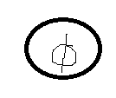
Conti…
0
0,1

